Slide 1
Optimize Prime
JAHNAVI SATISH SHANBHAG
NAYANA G M

Slide 2
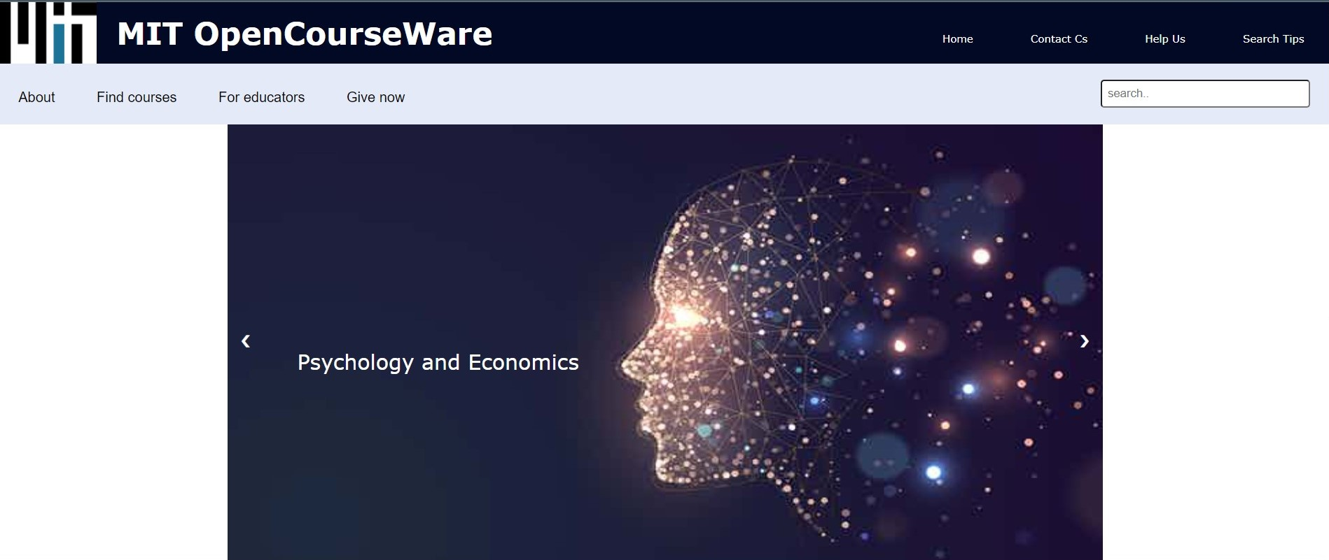
Navbar and Image Slider

Slide 3
Navbar top contains logo of mit , title, home, contact us, help us and search tips
NAVBAR DOWN CONTAINS ABOUT, Find courses , FOUR EDUCATORS, GIVE NOW, SEARCH BAR
IMAGE SLIDER HAS MANY IMAGES REALTED TO MIT COURSES

Slide 4
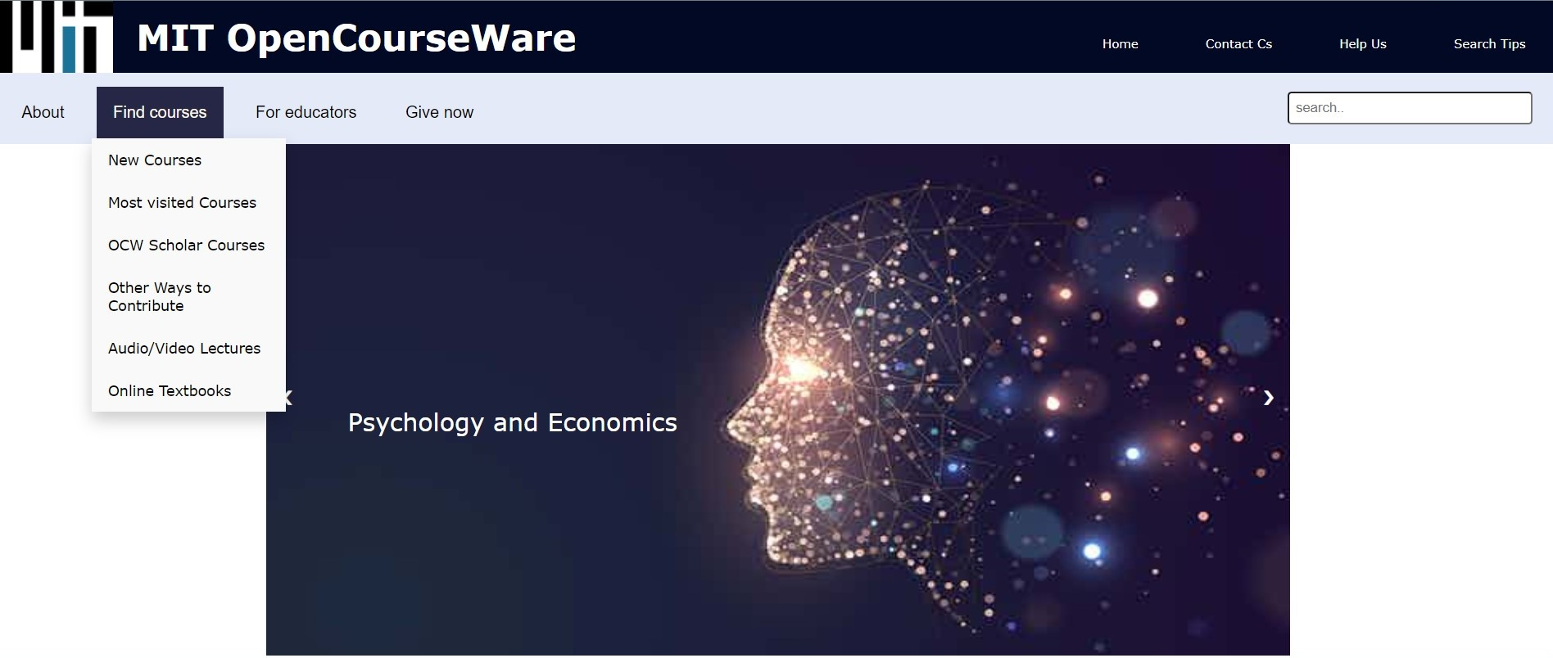
Dropdown Menu

Slide 5
DROP DOWN MENU LINKS IN EACH SECTION TO VISIT OTHER PAGES

Slide 6
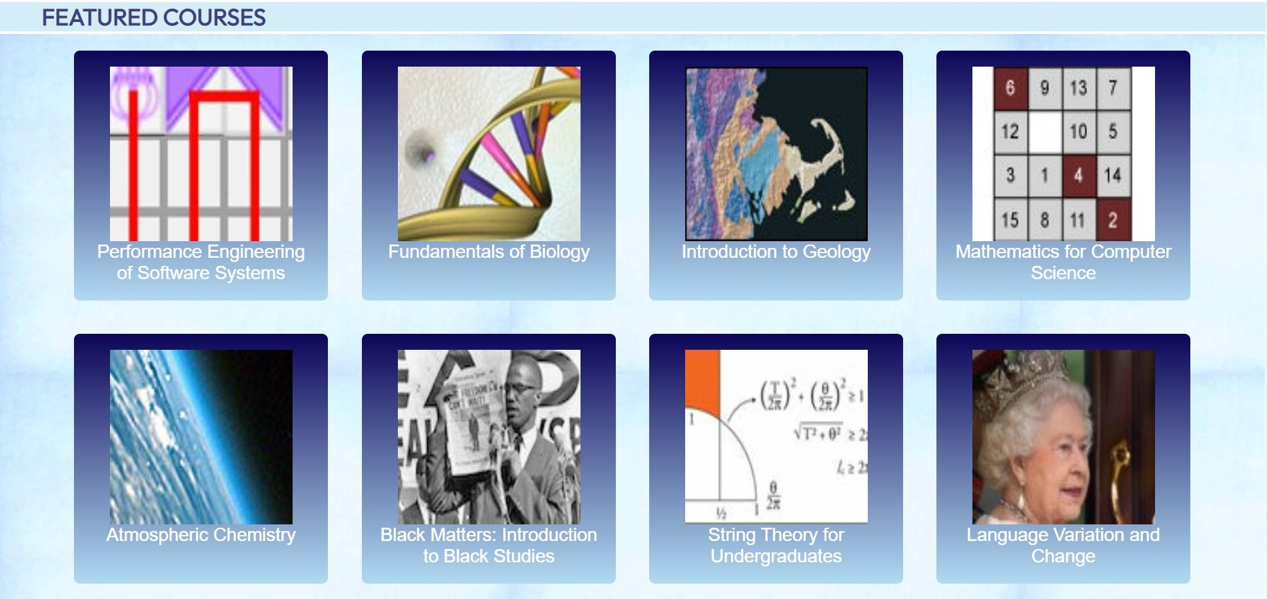
Grid Box for featured courses

Slide 7
Grid box
ALL THE FEATURED COURSES ARE KEPT INSIDE GRID BOX

Slide 8
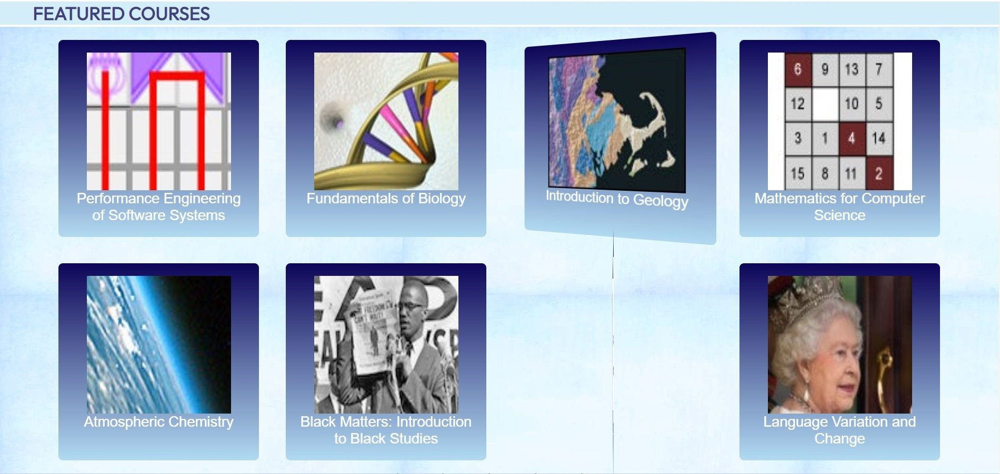
Grid with flip cards

Slide 9
GriD BOX WitH FLIP CARDS
ALL THE COURSES ARE KEPT AS FLIP CARDS TO IMPROVE THE UI

Slide 10
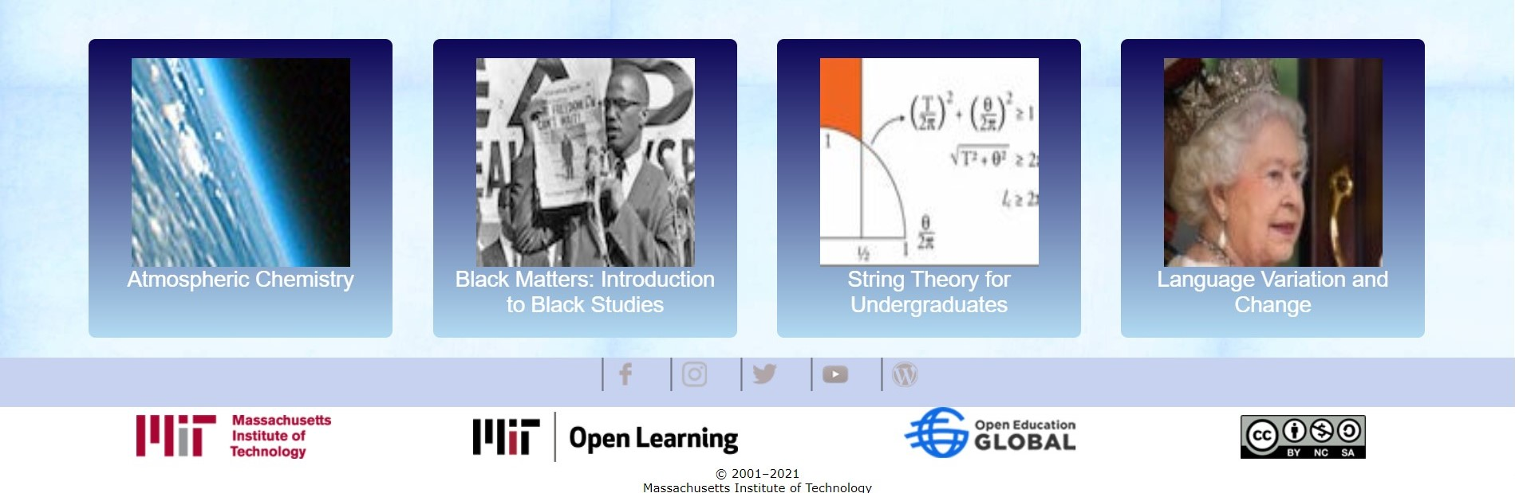
Social media and MIT partners

Slide 11
The bottom part of the web page has image links to visit mit social media pages
It also has logos of mit partners

Slide 12
tHANK you

